Slide 1

24753 - Customer Analytics Assignment 1C
Presented to:
Dr. Sonika Singh
Presented by:
Rahul Aryan Rajashekhar

Slide 2
Business Issue and Problem
Challenges:
Shifting consumer expectations toward health, sustainability, and customization
New competitors entering the plant-based segment
Risk of launching a product that fails to meet customer expectations
McDonald’s is seeking to diversify its product offerings by entering the growing market for plant-based burgers.
The demand for vegetarian and vegan options has been significantly increasing, especially among younger consumers like Gen Z and Millennials, driven by health, sustainability, and ethical concerns.
Advantages:
Strong brand presence and wide distribution network
Opportunity to lead in a high-growth segment with innovative offerings
Ability to leverage digital platforms for targeted marketing
Goal:
Use STP (Segmentation, Targeting, Positioning) to develop customer-backed product strategies that reduce launch risk and ensure market fit.

Slide 3
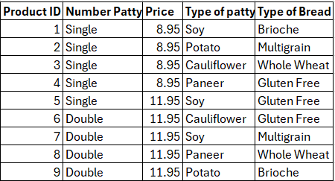
Survey Design and Conjoint Attributes
Product category: Plant-based burgers
Brand: McDonald’s
Attributes and Levels:
Patty Type: Paneer, Potato, Cauliflower, Soy
Bread Type: Multigrain, Brioche, Whole Wheat, Gluten Free
Number of Patties: Single, Double
Price: $8.95, $11.95
Full profile conjoint with 9 product profiles evaluated
Tool used: Qualtrics (for data collection)

Slide 4
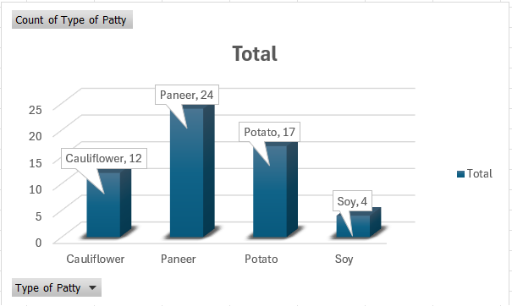
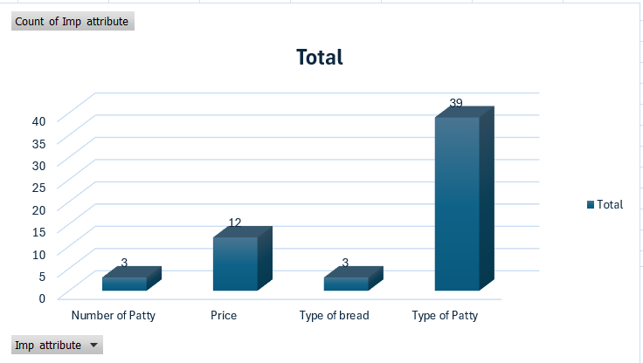
Survey Respondent Summary
Conjoint Analysis Results
Total respondents: 57
Age groups: Majority between 18-34 years
Gender: Male-dominant sample
Spending habits: Range from budget ($<10) to premium ($>20), majority around $10-$15
Most important attribute: Type of Patty (importance score: 39)
Preferred Patty: Paneer > Potato > Cauliflower > Soy
Preferred Bread: Multigrain
Price: $11.95 preferred, indicating quality perception
Most preferred profile: Profile 8 - Paneer, Double Patty, Whole Wheat, $11.95
Chosen by 21 out of 57 respondents.

Slide 5
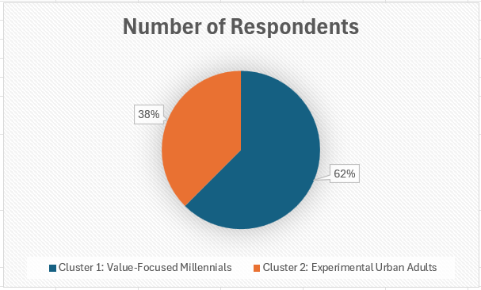
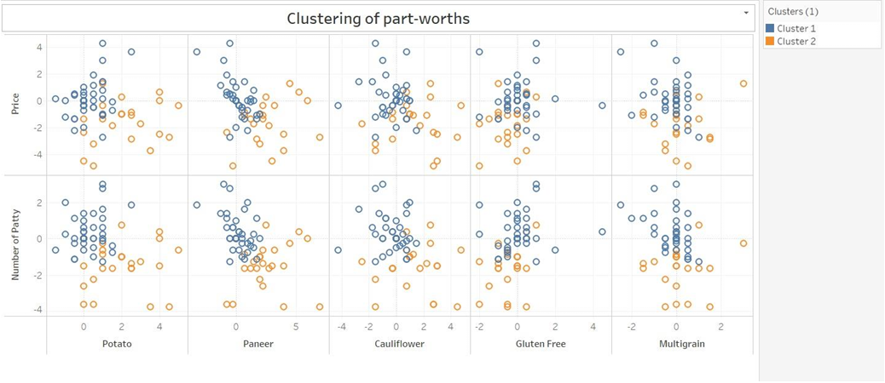
Segmentation Methodology
Cluster analysis conducted in Tableau using individual-level part-worth scores from conjoint analysis
Objective : To group customers based on similar preferences and identify actionable target segments for product positioning.
K-Means clustering algorithm automatically determined 2 optimal clusters
Clusters identified:
Cluster 1: Value-Focused Millennials (40 respondents)
Cluster 2: Experimental Urban Adults (24 respondents)
This segmentation enabled McDonald’s to uncover two clearly differentiated consumer groups based on their preference patterns, providing the foundation for precise targeting and positioning strategies.

Slide 6
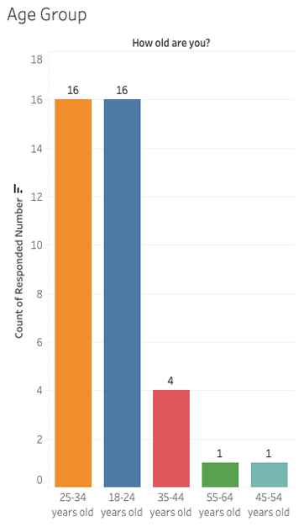
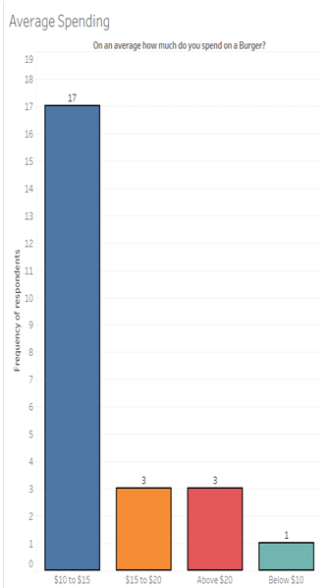
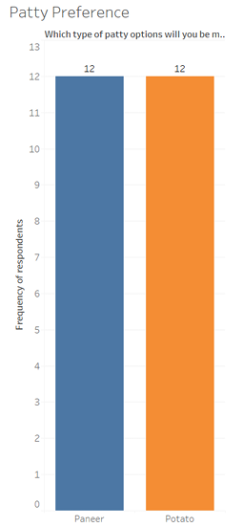
Cluster 1 Profile: Value-Focused Millennials
Size: 40 respondents
Demographics: Predominantly 18–34 years old; mix of students and young professionals
Preferences:
Strong affinity for Paneer and Potato patties
Interest in Gluten Free and Multigrain bread
Moderate preference for double patty but cost-sensitive
Price sweet spot: $10–$15
Behavioural Traits:
Budget-conscious yet open to variety
Looks for value meals and deals
Strong brand familiarity with McDonald’s
Marketing Strategy:
Campus activations and student discount promotions
Combo meal bundles and loyalty rewards
Leverage mobile app push notifications and in-app offers

Slide 7
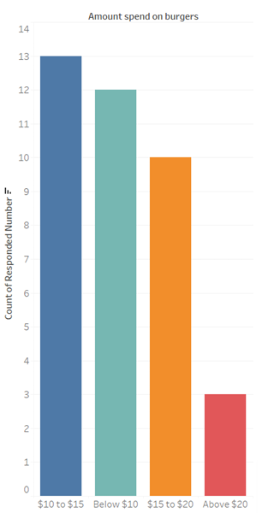
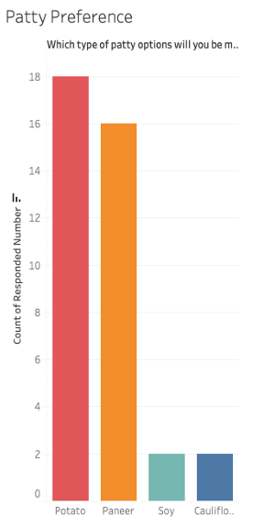
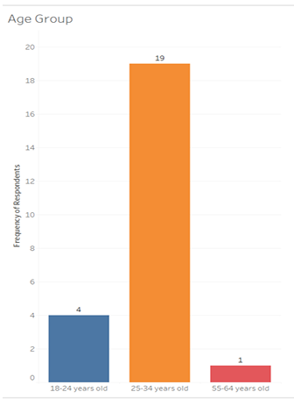
Cluster 2 Profile: Experimental Urban Adults
Size: 24 respondents
Demographics: Primarily males aged 25–34; likely young professionals in urban areas
Preferences:
Strong interest in Potato and Paneer patties
Preference for Single patty options
Shows a mix of price sensitivity—some value and some premium preferences
Bread choice flexible but leans toward variety and novelty
Behavioural Traits:
More experimental in food choices
Interested in unique or limited-time offerings
Likely influenced by health trends, sustainability, and social media
Marketing Strategy:
Use influencer marketing to create awareness and credibility
Promote sustainability and unique ingredients through storytelling
Emphasize customization and exclusivity via digital campaigns

Slide 8
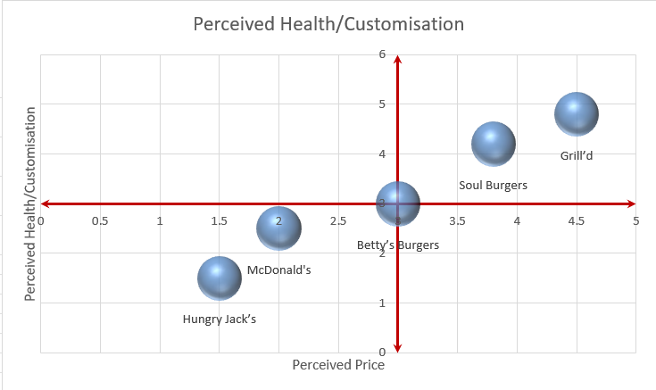
Positioning Analysis
A perceptual map was created to compare McDonald’s with key plant-based burger competitors in the Australian market
X-axis: Perceived Price (from Low to High)
Y-axis: Perceived Health/Customisation (from Low to High)
Competitors included: Hungry Jack’s, Betty’s Burgers, Soul Burgers, Grill’d
Visual Insights:
Grill’d: High health perception, high price
Soul Burgers: High customisation, slightly less known, moderate-high price
Betty’s Burgers: Strong in brand but moderate on health perception
Hungry Jack’s: Affordable, familiar but low in health and customisation
McDonald’s (Current Perception): Lower-mid on health, high on value but low customisation

Slide 9
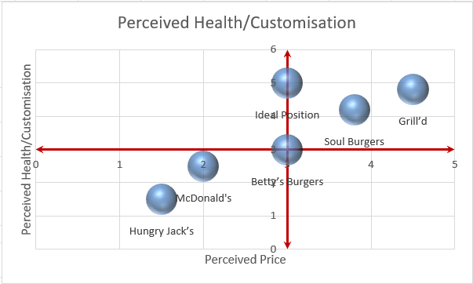
Positioning Gap and Strategic Opportunity
Gap Identified: No brand currently occupies the space offering high customisation and health at a mid-price point
Ideal Position: A customizable, healthy, plant-based burger that is still affordable and convenient
McDonald’s can reposition by offering:
Customisable Paneer-based burger with healthier bread and topping options
Priced competitively at $11.95
Strategic Opportunity:
Capitalize on McDonald’s brand trust and scalability
Attract both value-seekers and health-conscious urban consumers
Analysis of segment positions revealed a clear white space: a product that combines health, familiarity, and customisation at a mid-premium price point
This gap presents an opportunity for a differentiated product offering that meets the latent needs of both identified segments
The ideal position is centrally located between value and premium zones, with strong alignment to current brand equity and evolving customer demands

Slide 10
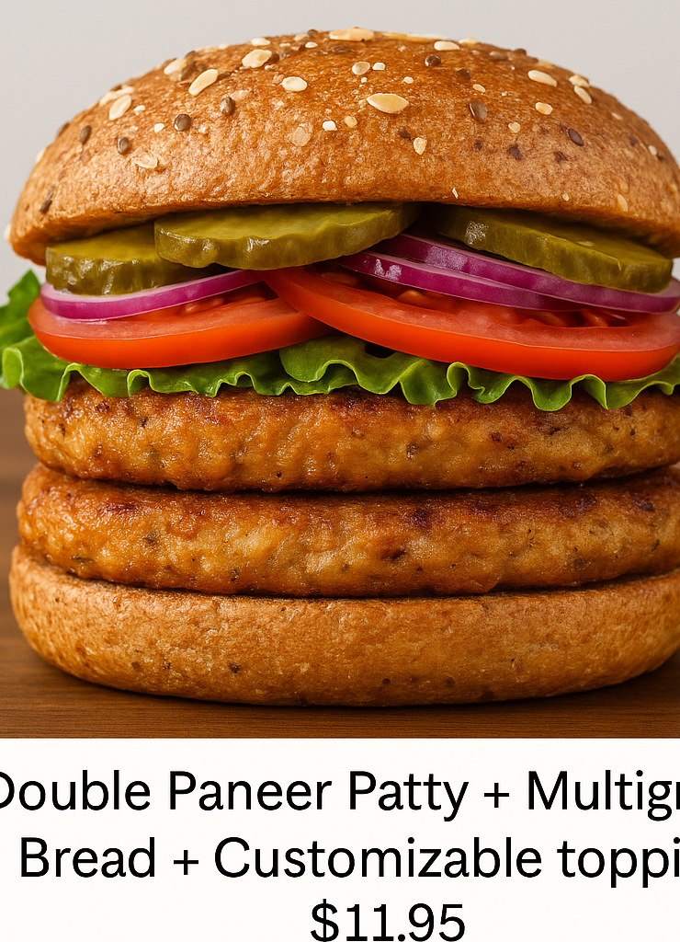
New Product Concept
Concept: Double Paneer Patty + Multigrain Bread + Customizable toppings + $11.95
Positioned to occupy the ideal zone between affordability and premium experience
Combines the top two preferred patty types (Paneer and Potato) with healthy bread and a customizable format
Designed to appeal to both identified clusters:
Value-Focused Millennials: familiar ingredients, mid-range pricing, gluten-free option
Experimental Urban Adults: customization, indulgence, health-conscious perception
Strategically aligned with the Ideal Position (X=3, Y=5) on the perceptual map
Fits between value and premium offering
Appeals to both taste & health-conscious segments

Slide 11
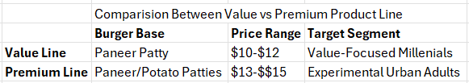
Insights and Managerial Recommendations
McDonald's should launch dual product lines to cater to both value-conscious and health-driven consumers:
Value Line: Classic Paneer burger at $10–$12 with minimal customization for speed and affordability
Premium Line: Customizable patty (Paneer/Potato) options with healthy bread choices at $13–$15, positioned as a "Healthy Indulgence"
Emphasize quality through pricing and ingredient familiarity to reinforce brand trust
Align product offerings with the ideal perceptual zone to satisfy cross-segment demand
Integrate both lines into digital ordering platforms to support personalised upselling and repeat purchase behaviour
Use limited-time offers to test and evolve new patty or topping options for ongoing innovation

Slide 12
Digital Marketing Plan (6-Month)
Platforms: Instagram, YouTube, Meta Ads, Google Search
Monthly Budget: AUD 1000 (Total: AUD 6000)
Messages will highlight: "Healthy indulgence," "Customisable veggie delight," and value-driven bundles
Use tracking pixels and UTM tags to monitor campaign effectiveness
Campaign Focus by Month:
Month | Activity | Objective
1–2 | Influencer tie-ins | Build awareness among Gen Z
3–4 | Google Search Ads (SEM) | Capture intent-driven traffic
5–6 | In-app coupons & promo push | Drive conversions and retention

Slide 13
SEO and SEM Strategy
SEO Strategy:
Focus on optimizing McDonald’s plant-based burger landing page to rank organically for high-intent keywords
Target Keywords: "Healthy burgers", "Vegetarian McDonald's burger", "Paneer burger McD"
On-page SEO: Use keyword-rich headings (H1, H2), meta descriptions, and alt-text for burger images
Content Strategy: Publish blog content on nutrition benefits, sustainability, and customization options
Backlink Plan: Partner with local food bloggers or sustainability influencers for organic inbound links
SEM Strategy:
Platform: Google Ads (Australia) targeting food-conscious, value-driven customers
Ad Formats: Responsive search ads and Google Display Network banners showing the burger concept
Analytics & Tracking: Use UTM parameters and Google Analytics to track CTR, bounce rates, and conversions
Landing Page: Visually engaging product page featuring build-your-own burger tool, price breakdown, and links to order via app
A/B Testing Plan:
Element | Variation A | Variation B
Headline | “Try Our New Healthy Burger” | “Customise Your McD Veggie Burger”
CTA Button | “Order Now” | “Explore Toppings”

Slide 14
Summary and Conclusion
The project identified two distinct customer segments—Value-Focused Millennials and Experimental Urban Adults—through data-driven conjoint and cluster analyses
A double Paneer patty burger with multigrain bread and customisable toppings at $11.95 fits the sweet spot of preference and market positioning
The ideal positioning balances price sensitivity and health-conscious indulgence, backed by a clear gap in the perceptual map
Strategic recommendations include dual product lines and a targeted 6-month digital marketing plan with focused SEO/SEM execution
McDonald’s is well-positioned to lead the plant-based category by combining brand familiarity with modern, customisable offerings

Slide 15

Thank You

